Slide 1
22/5/25

Slide 2
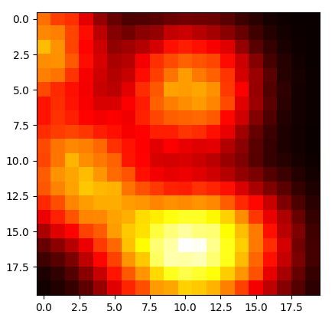
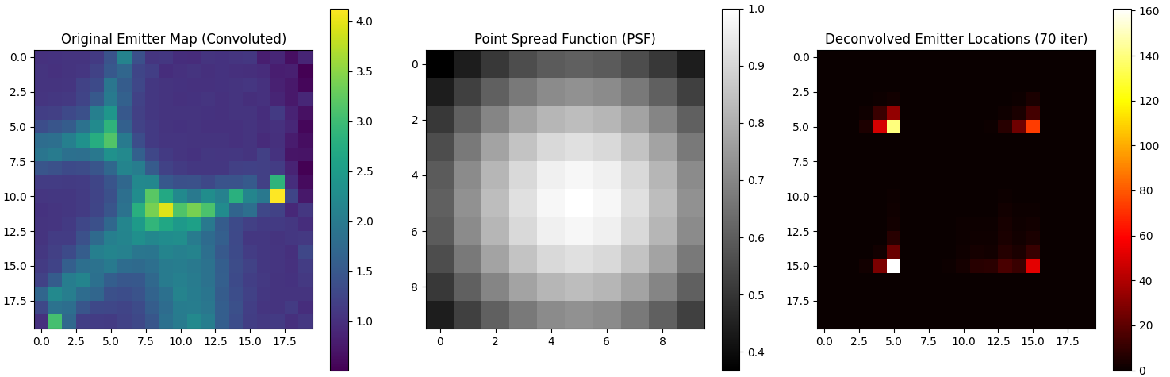
Richardson-Lucy deconvolution

Slide 3
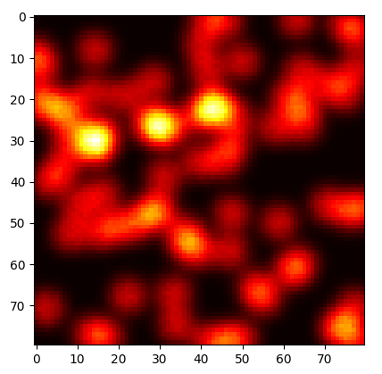
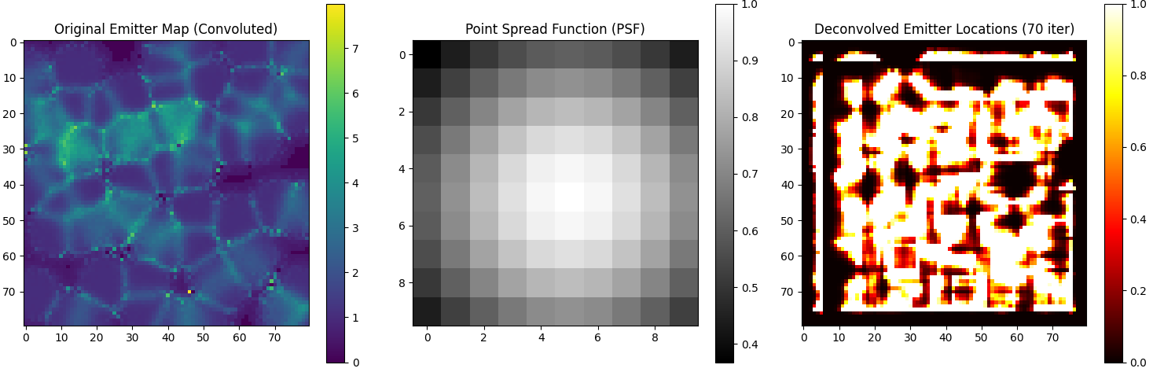

Slide 4
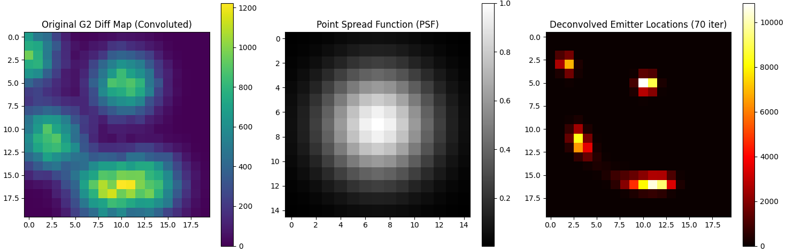
Richardson-Lucy deconvolution

Slide 5
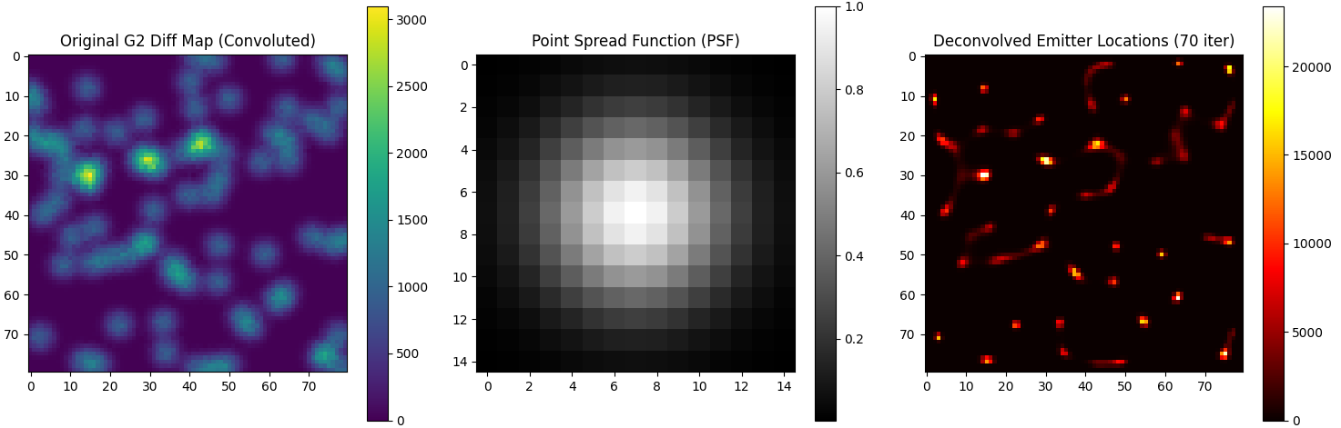
1pix=0.05um
Idea: find ROI’s based on deconvolved G2 diff: much smaller ROI’s!

Slide 6
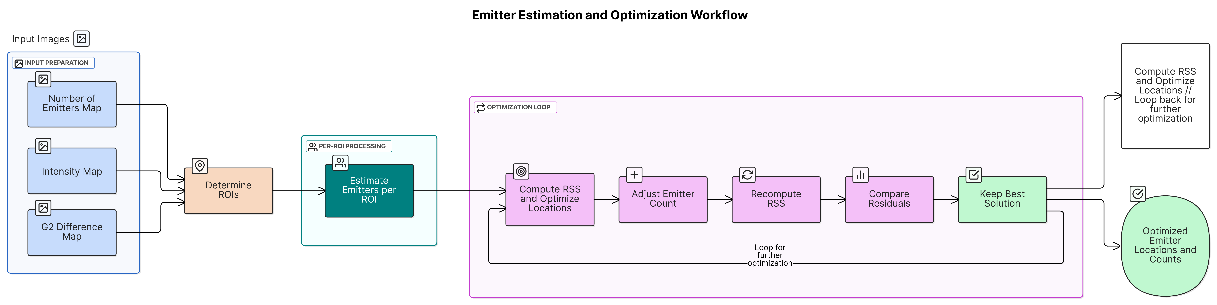
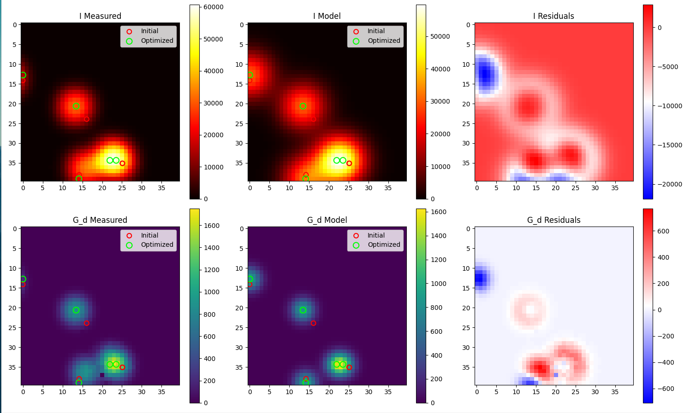
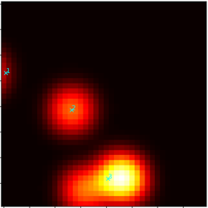
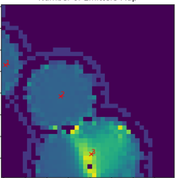
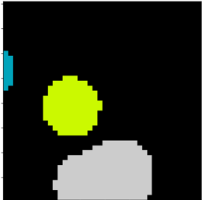
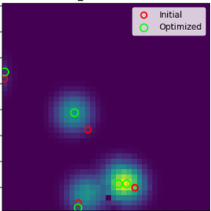
Localization workflow
Deconvolve G2Diff
Notes:
Determines ROI using filtering.
Estimate emitter count per ROI by taking maximum over the ROI.
Use centroids of ROI as initial positions with then umber of emitters being equal to the count found in (2). Then optimizing with RSS, optimizing with a small change in the emitters/ROI and comparing.

Slide 7
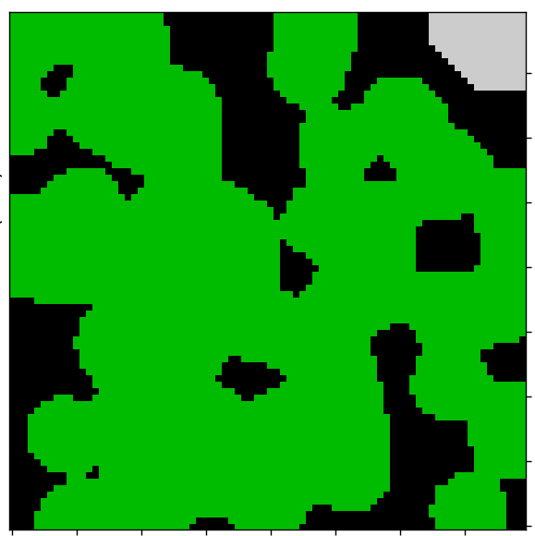
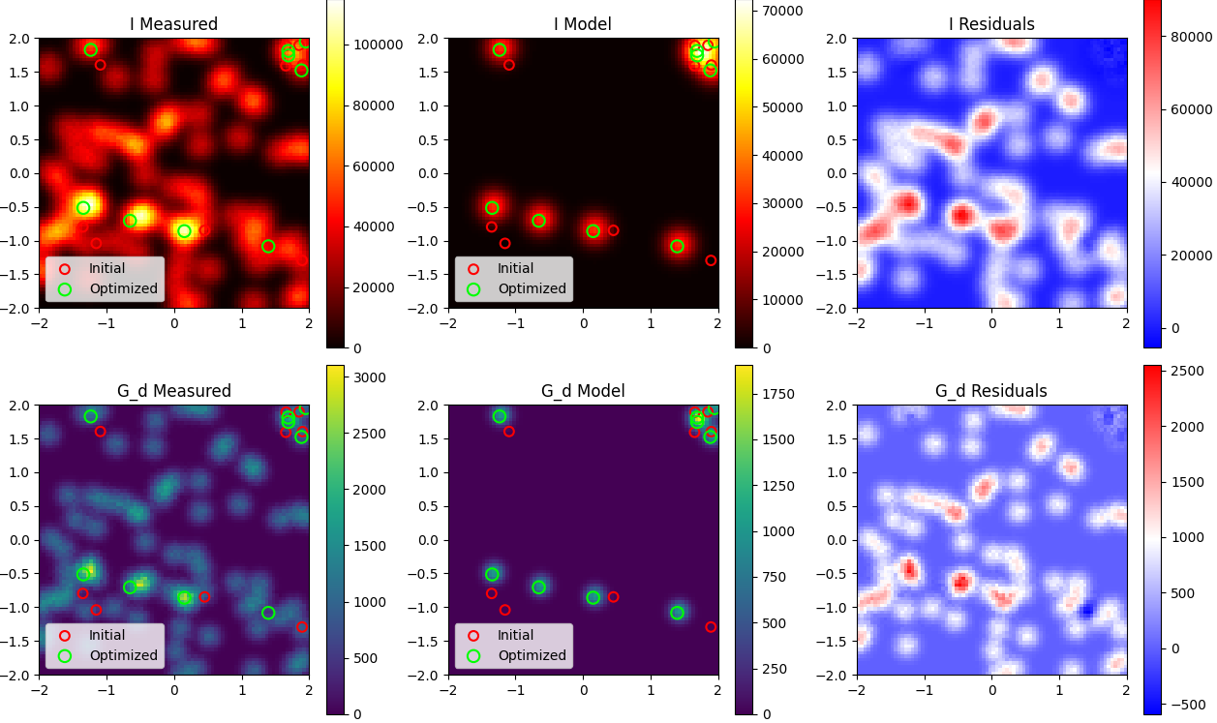
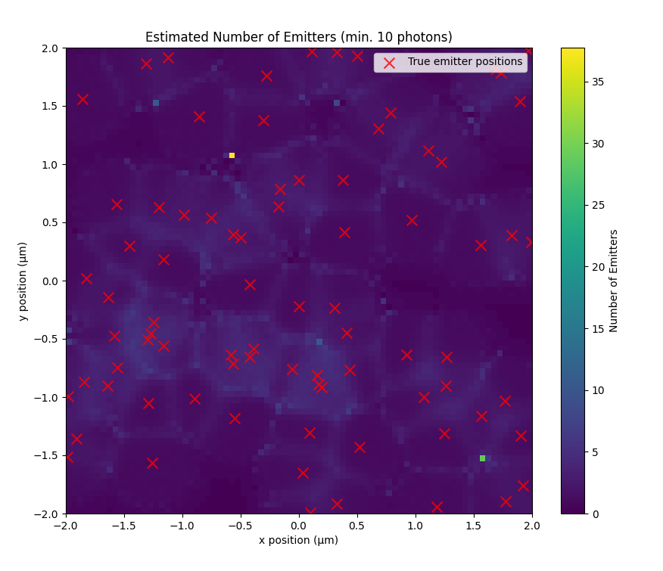
Last week’s problem: too large ROI => underestimation of n

Slide 8
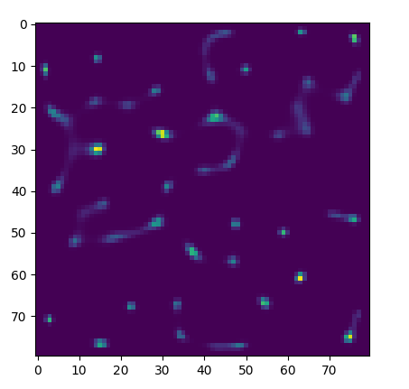
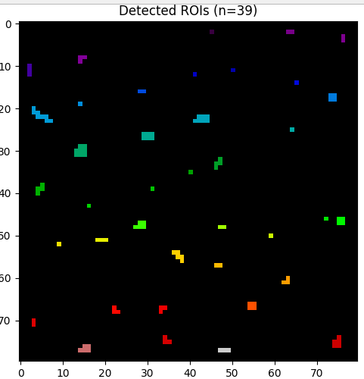
Deconvolution

Slide 9
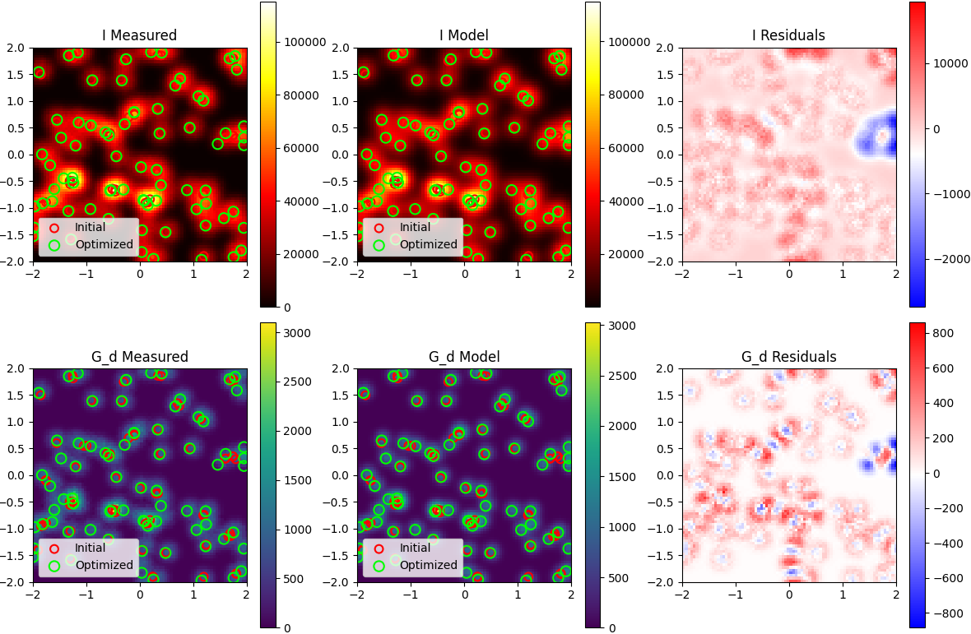
Solved
Jaccard index of emitters (eye-balled it): 66/(66+3+9)=0.85 in this image

